Slide 1
Progress on scaling up HIV prevention
Maeve Brito de Mello, B.Sc., Ph.D.
Regional Advisor for HIV/STI Prevention
Pan American Health Organization / World Health Organization
@TwitterHandle

Slide 2
I have no conflict of interest

Slide 3

Outline
Progress in preventing new HIV infections
Impact of combination HIV prevention in high and low prevalence settings
Emerging evidences on the role of structural factors
Lessons learned towards scaling up HIV prevention
Final remarks

Slide 4
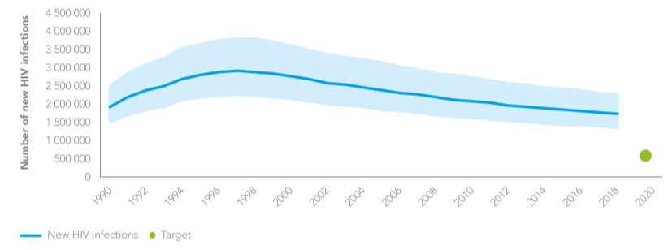


Estimated trend in number of new HIV infections globally, 1990-2018, and 2020 target

Slide 5



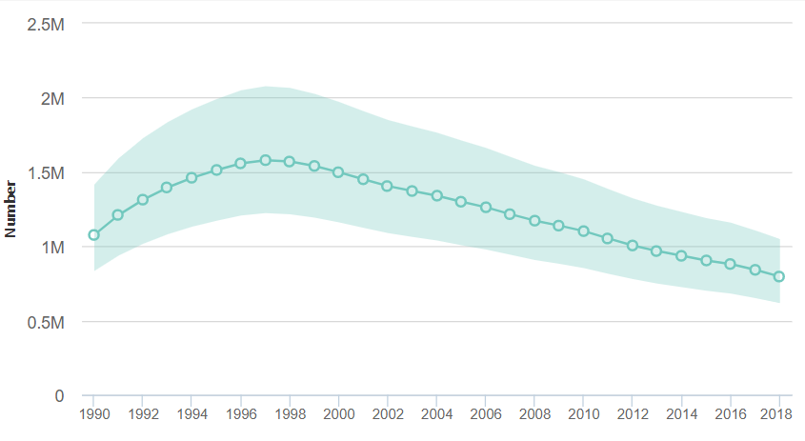
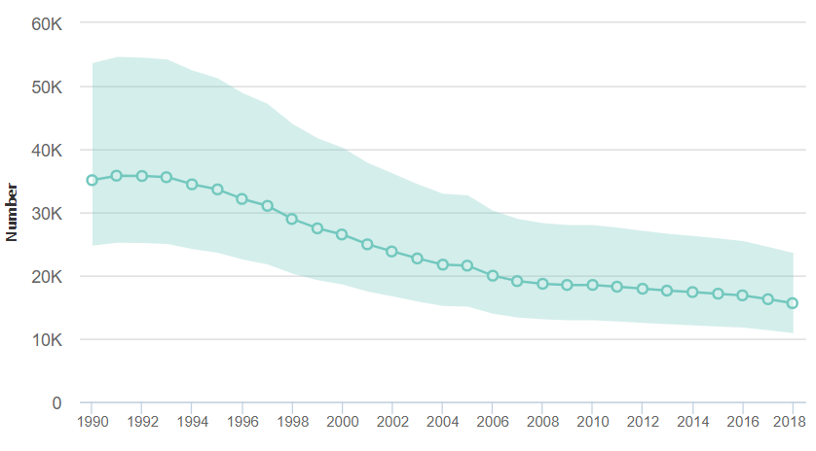
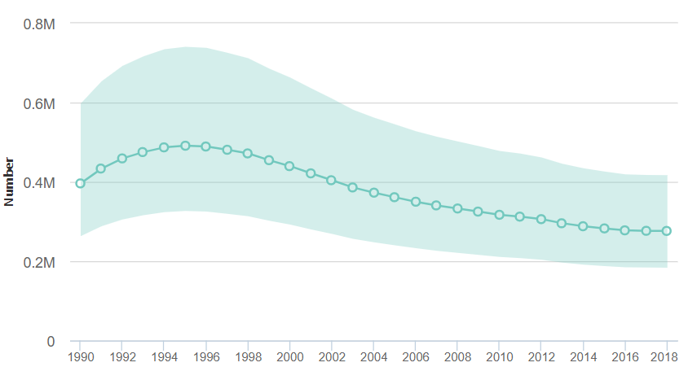
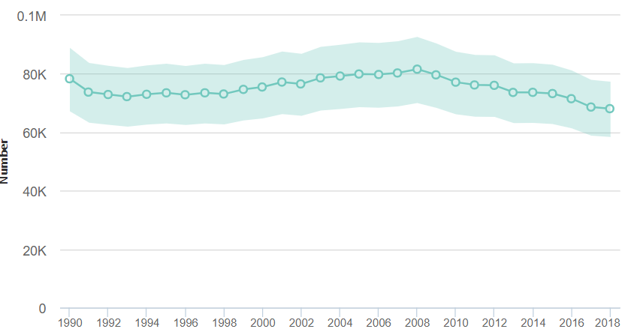







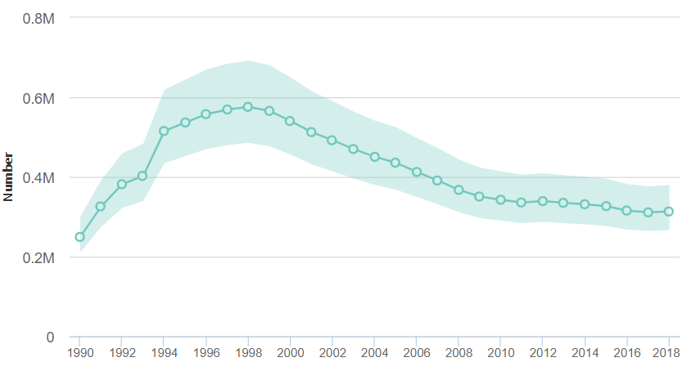
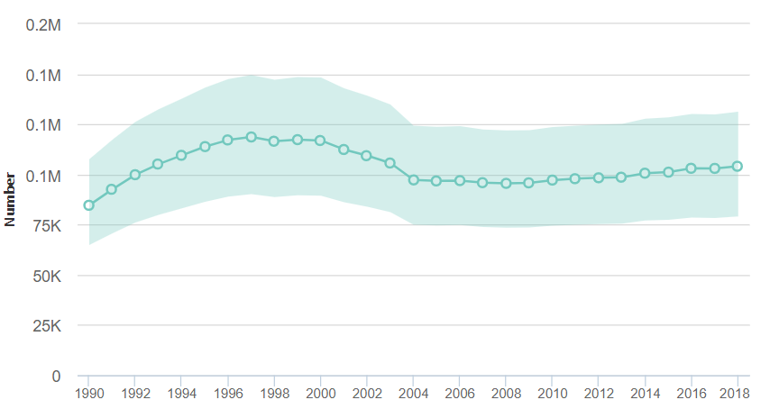
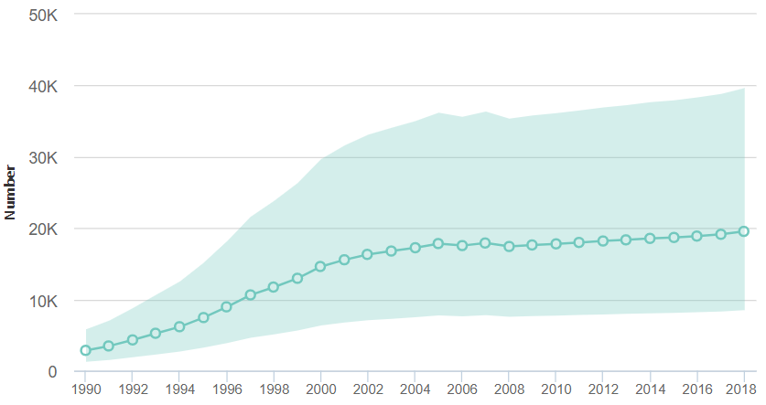
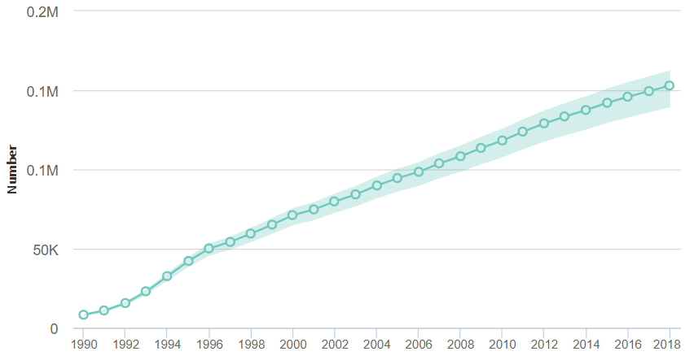





Estimated trends in new HIV infections and % reduction between 2010-2018

Slide 6
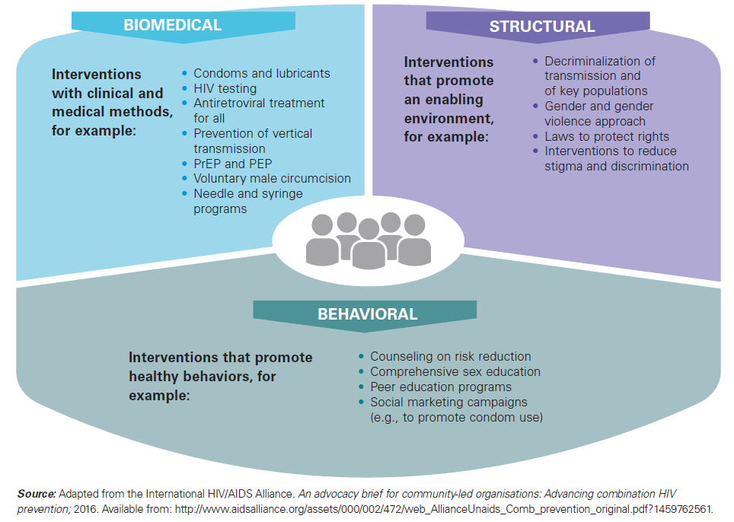
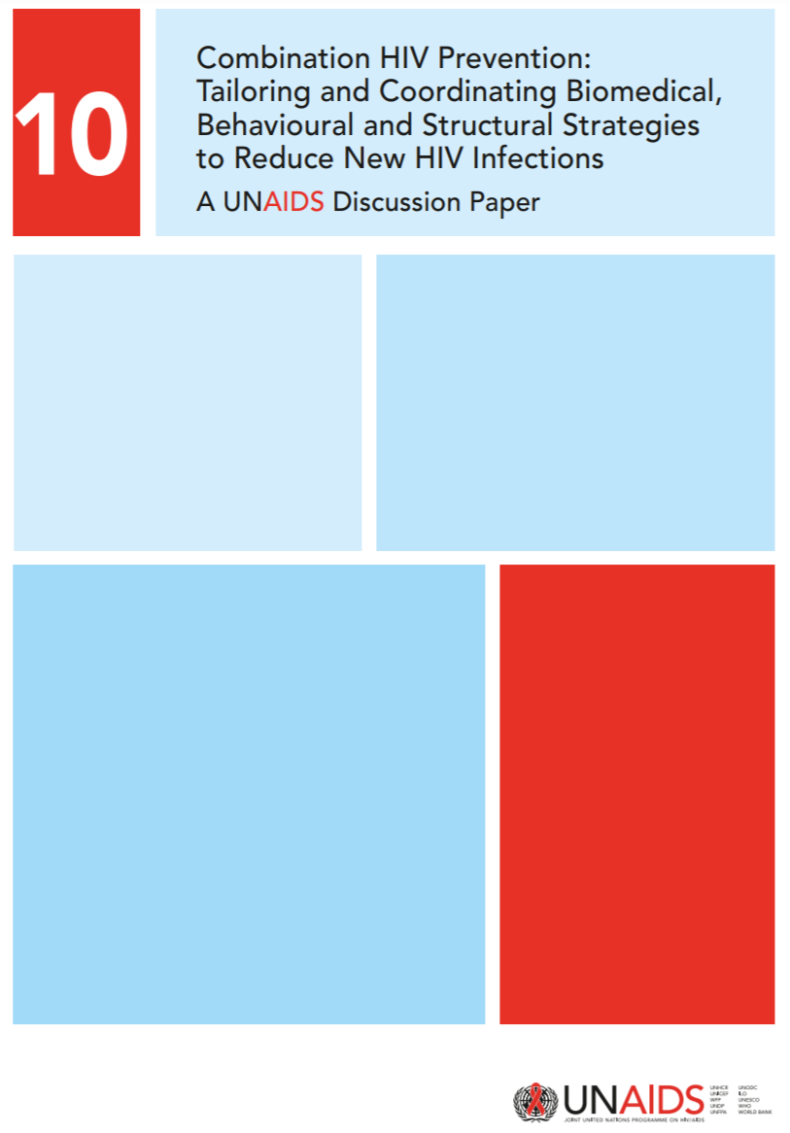
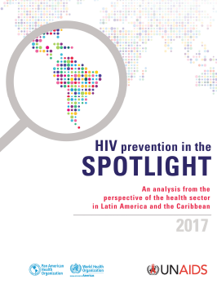

Slide 7
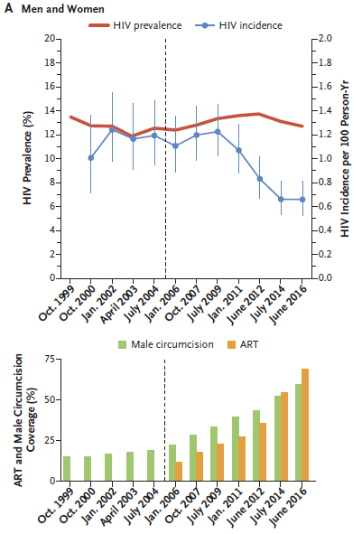
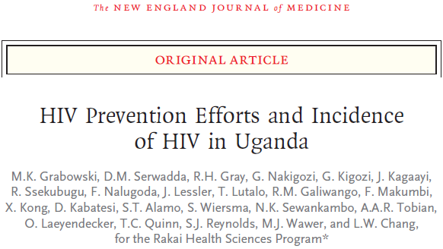


Slide 8
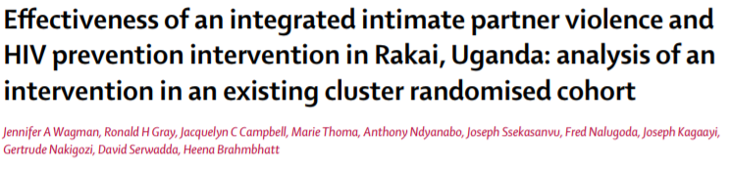

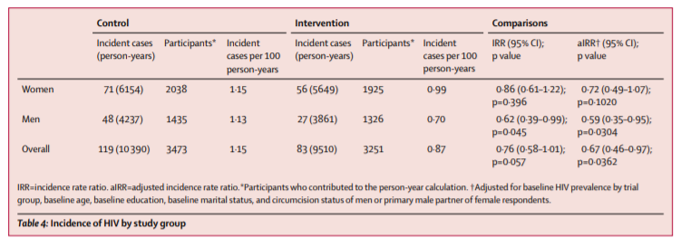
Women in SHARE reported fewer past-year physical (16 vs. 12%) and sexual IPV (13 vs. 10%)
Association after 35 months with reduction in HIV incidence 1.15 vs. 0.87 cases/100 person-years

Slide 9
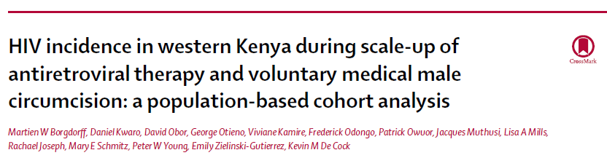
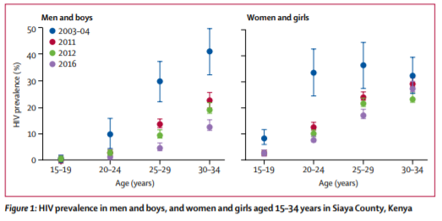
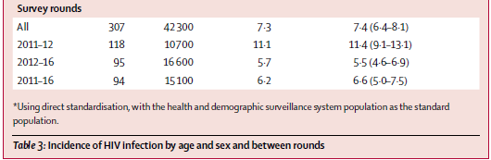
Incidence declined as VMMC, HIV-testing, and ART were rapidly scaled-up

Slide 10

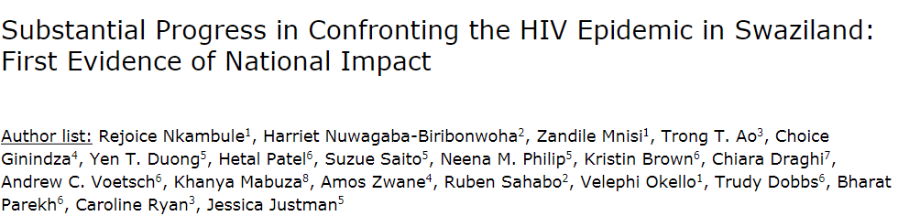

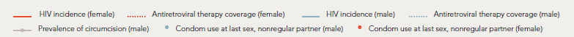
Population HIV Impact Assessment (PHIA)
Swaziland HIV Incidence Measurement Survey (SHIMS)
2011 SHIMS-1 vs. 2016-2017 SHIMS-2
HIV incidence among adults 18-49 years-old
2.48% [1.96, 3.00] 1.39% [0.83, 1.94]
44% decrease
Viral Load Suppression among adults 18-49 years-old
34.8% [33.4, 36.2] 71.3% [69.0, 73.5]
105% increase

Slide 11


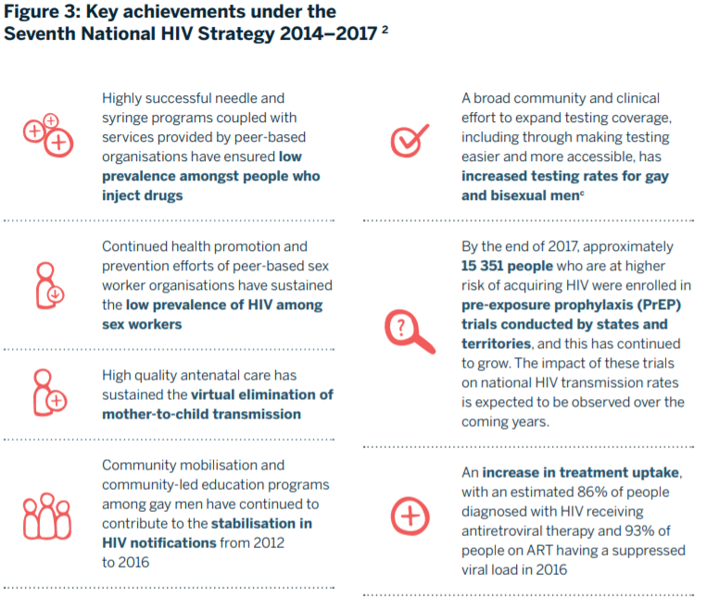
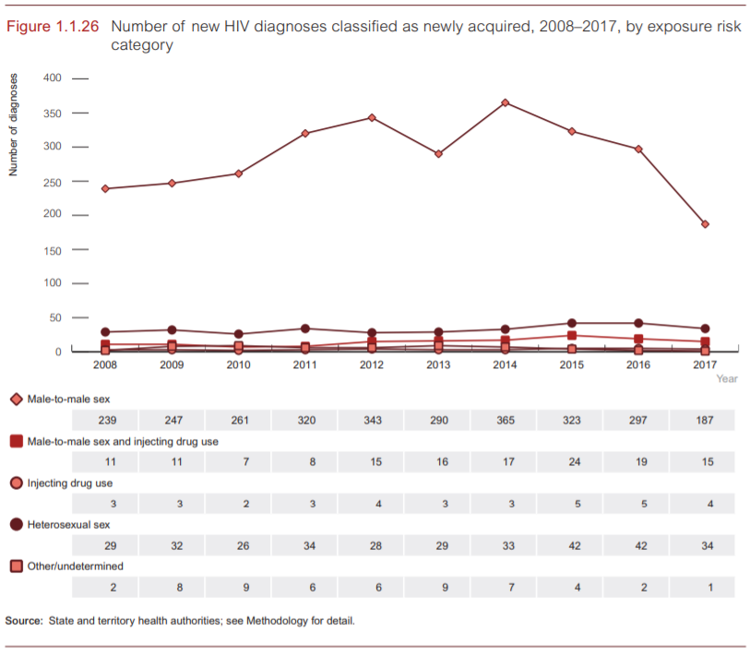
© The Kirby Institute for infection and immunity in society 2018
Focus on KP:
Successful harm-reduction program
Peer-based health promotion
Community mobilization & engagement
Rapid PrEP scale-up
Accessible and acceptable HTS
& High-quality ANC
92 – 97 – 95+ (2017)*
* Source: UNAIDS special analysis, 2019

Slide 12
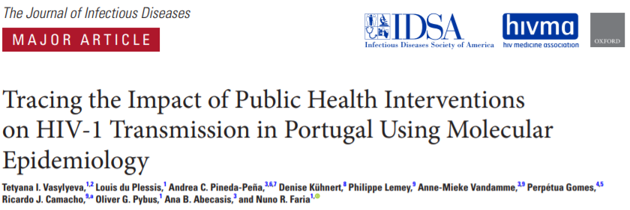
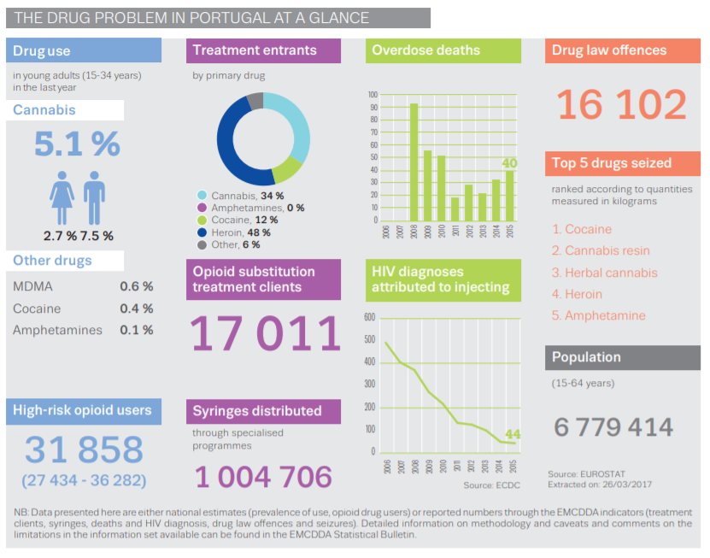
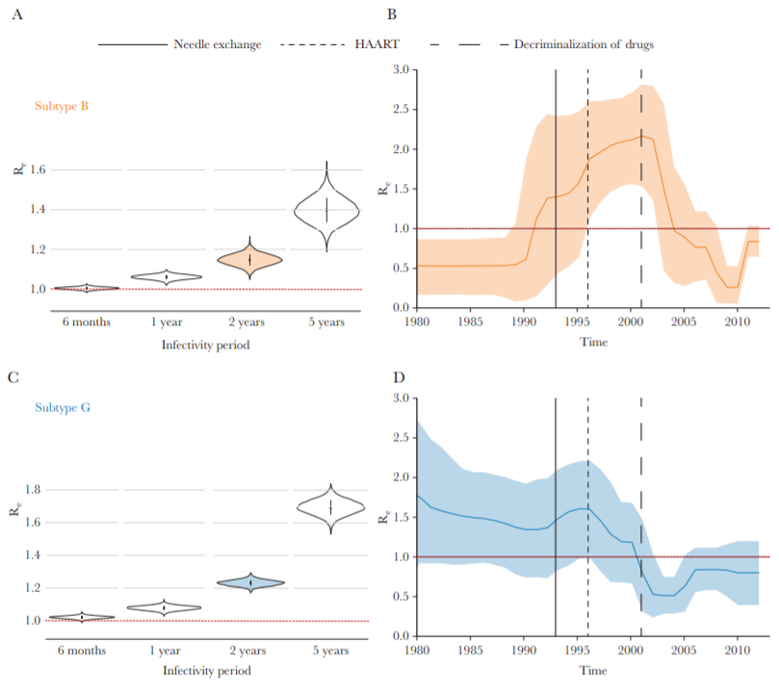


Slide 13
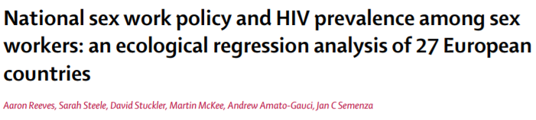
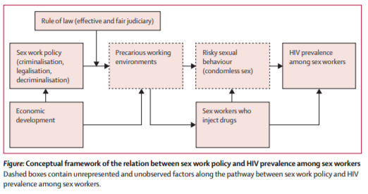
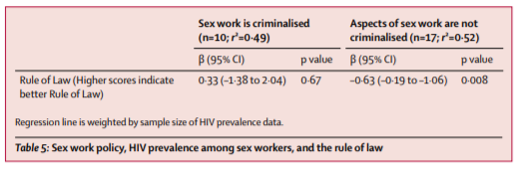
Legalizing some aspects of sex work was associated with:
lower HIV prevalence among SW
Less sex workers injecting drug

Slide 14

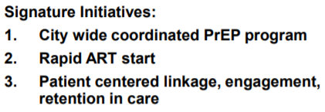
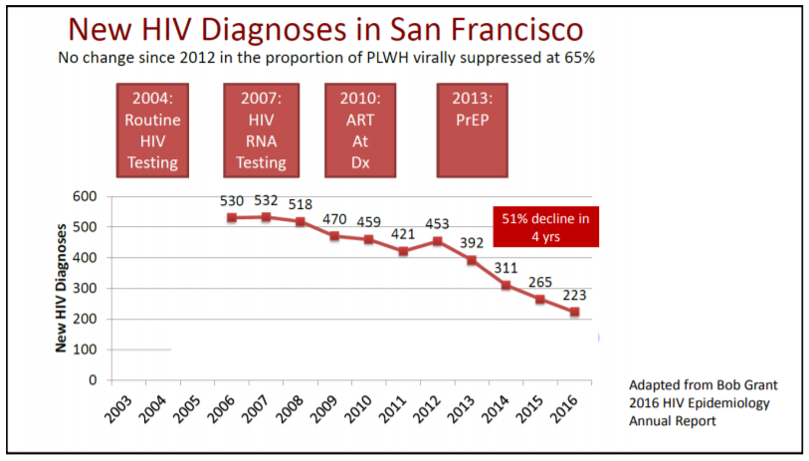
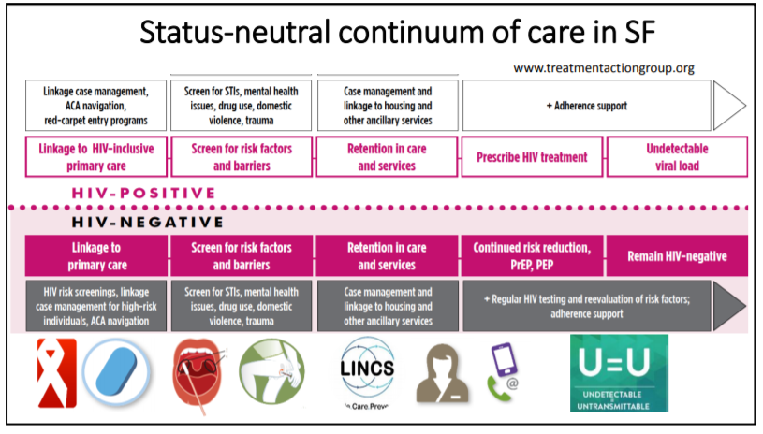


Adapted from D. Sachdev, 2018
https://courses.nnptc.org/resource.php?id=444&ret=my_resources

Slide 15

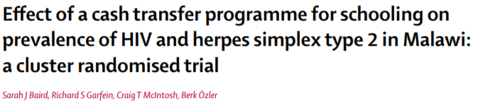
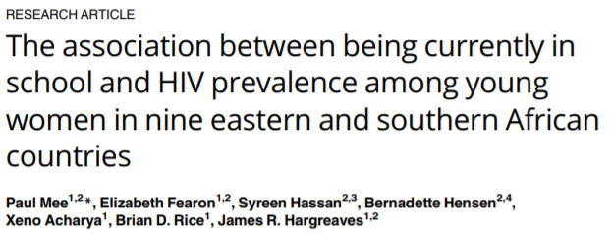
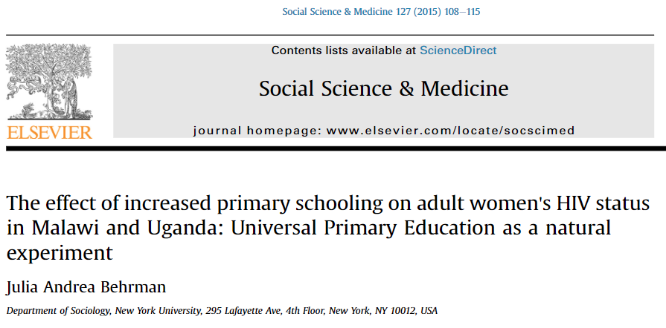

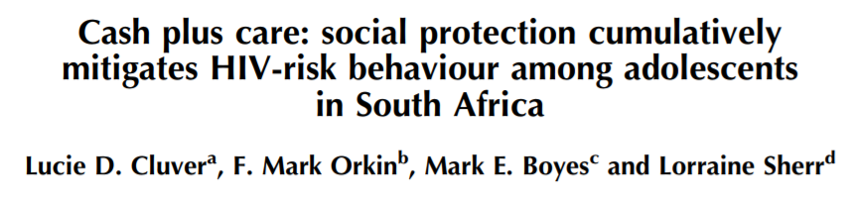
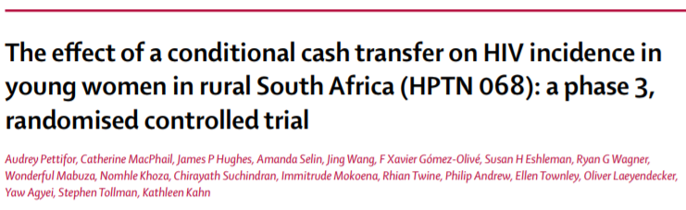
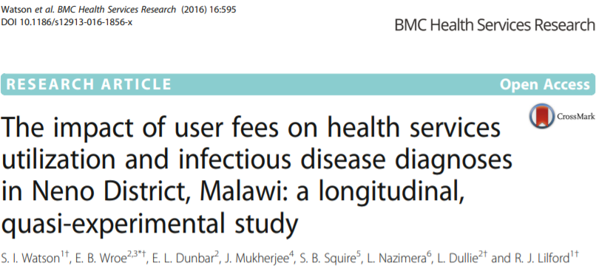


Slide 16

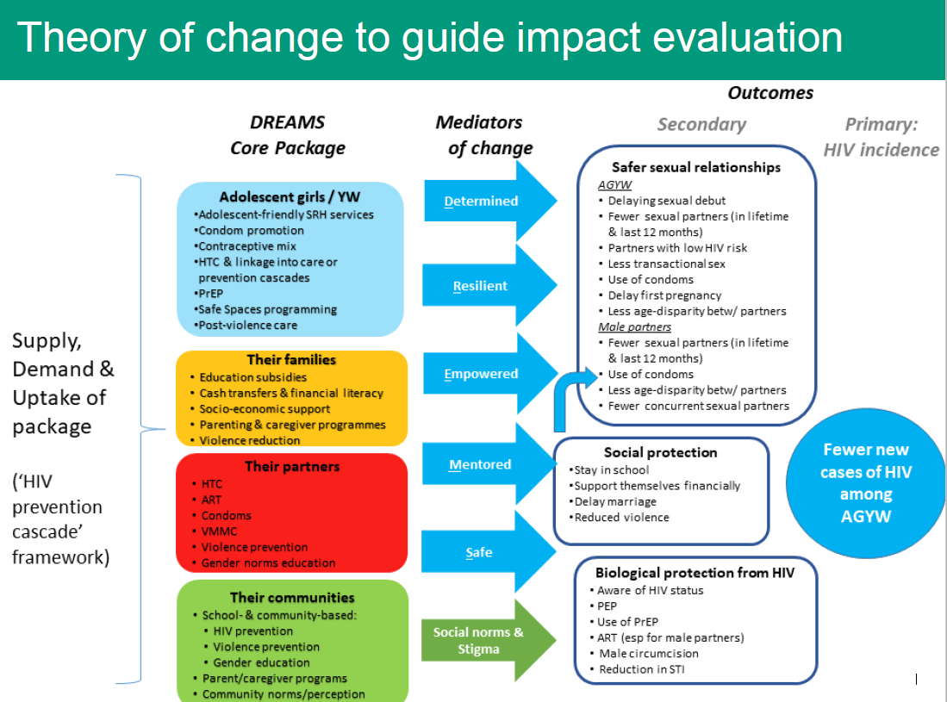
Source: I. Birdthistle, 2018

Slide 17
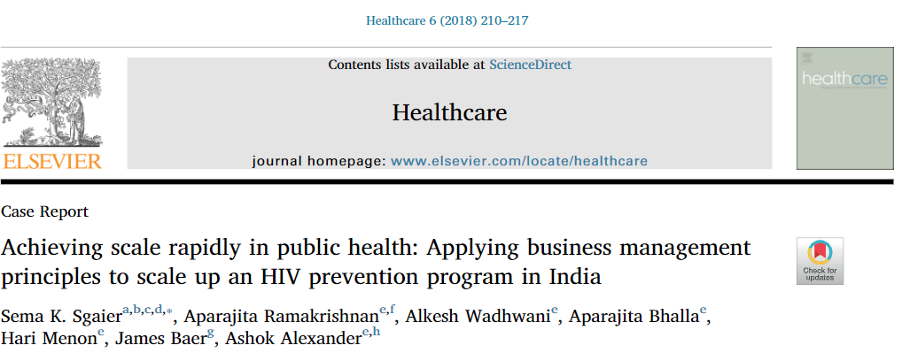

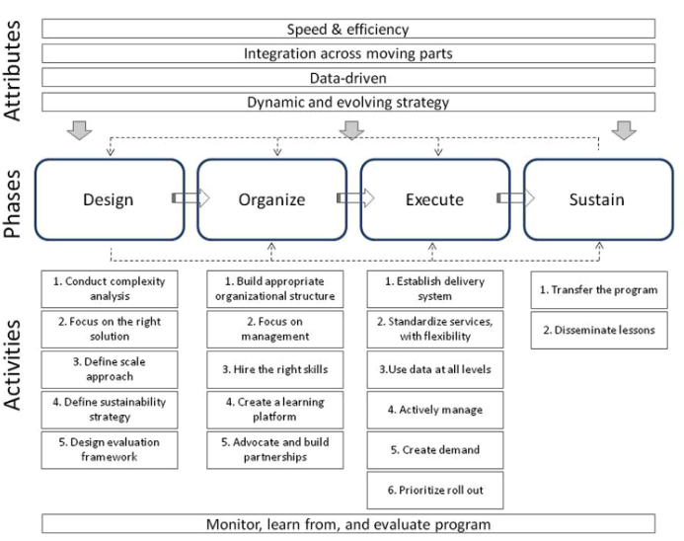
data guiding decision-making and strategic and programmatic change
central body to set strategy
willingness to change course
community engagement

Slide 18
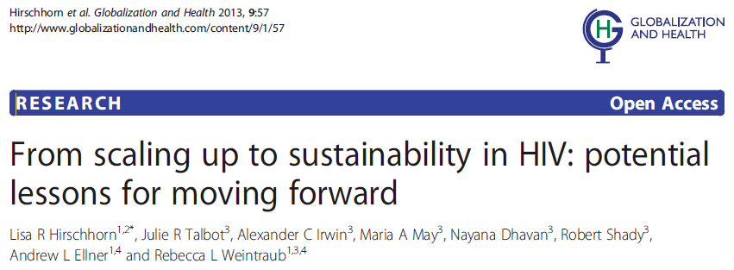
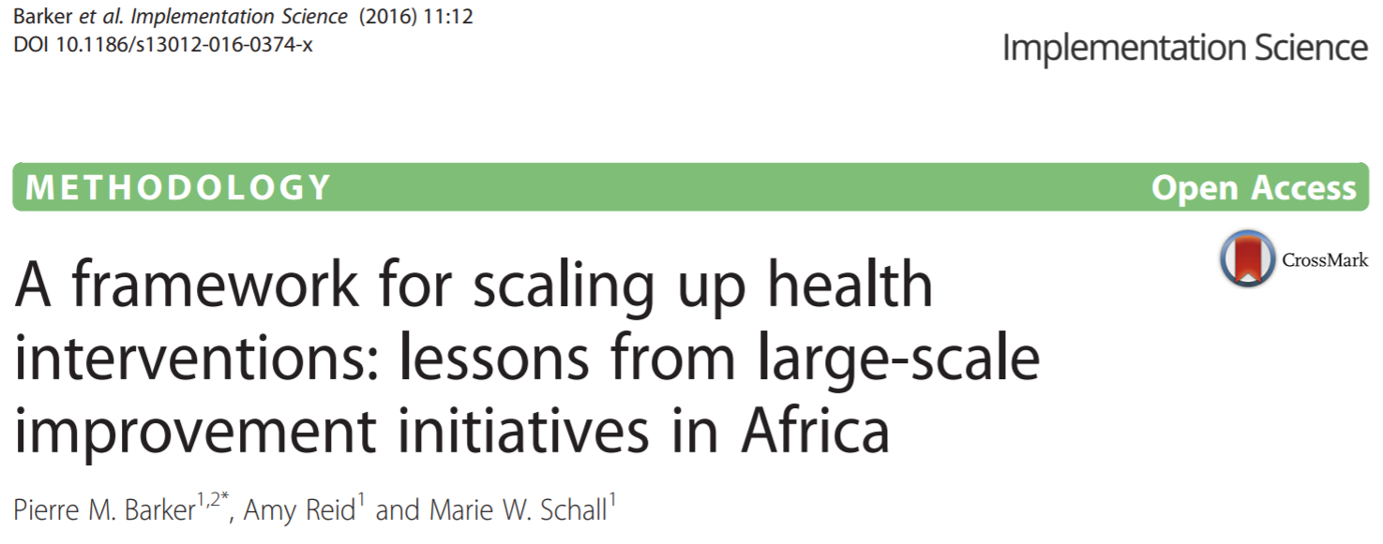
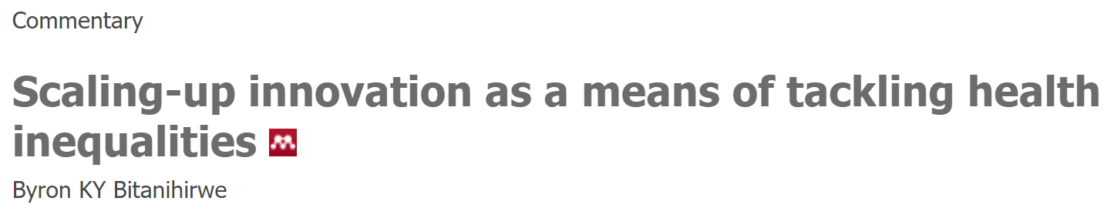



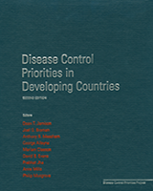
fiscal support
political support
community involvement, integration, buy-in, and depth
partnerships
balancing flexibility/adaptability and standardization
supportive policy, regulatory, and legal environment
building and sustaining strong organizational capacity
country ownership
decentralization
ongoing focus on sustainability
emphasizing inequities
Medlin CA, Chowdhury M, Jamison DT, et al. Improving the Health of Populations: Lessons of Experience. In: Jamison DT, Breman JG, Measham AR, et al., editors. Disease Control Priorities in Developing Countries. 2nd edition. Washington (DC): The International Bank for Reconstruction and Development / The World Bank; 2006. Chapter 8.Available from: https://www.ncbi.nlm.nih.gov/books/NBK11736/ Co-published by Oxford University Press, New York.

Slide 19

Policies & norms,
Existence or not of high quality, accessible, acceptable, affordable, effective and stigma-free health services
maximum
vulnerability
Age, sex, gender
Educational level
Knowledge
Values, beliefs
Sexual practices
Interpersonal relationships, etc.
High
Vulnerability related to the NAPS
Intermediate
Low
High
Intermediate
High
Individual vulnerability
Low
Intermediate
Gender, racial, ethnical, intergenerational relations
Punitive or protective laws
Access to employment, education, housing, justice, etc.
Social vulnerability
Low
“V₀”=minimal vulnerability

Slide 20
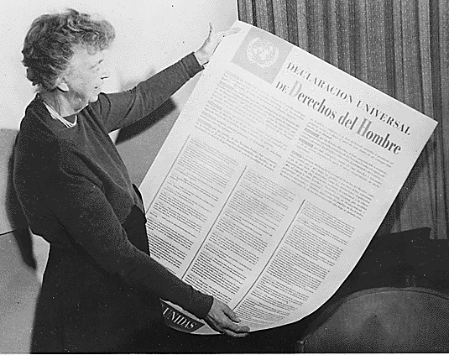


Slide 21
Thank you!

